Slide 1
IET Review-1
Grievances Registration and Management System
-Hafil. A
-22bct017

Slide 2
Introduction To Company
Live Stream Technologies
No 207, AK Complex - 2nd Floor,
6th Street – Cross-cut road,
Opp Shree Devi Textiles (2nd Car Parking),
Gandhipuram, Coimbatore-12
ISO 9001:2015 CERTIFIED COMPANY
Email: info@livestreamtechnologies.co.in / hr@livestreamtechnologies.co.in
Web: www.livestreamtechnologies.co.in

Slide 3
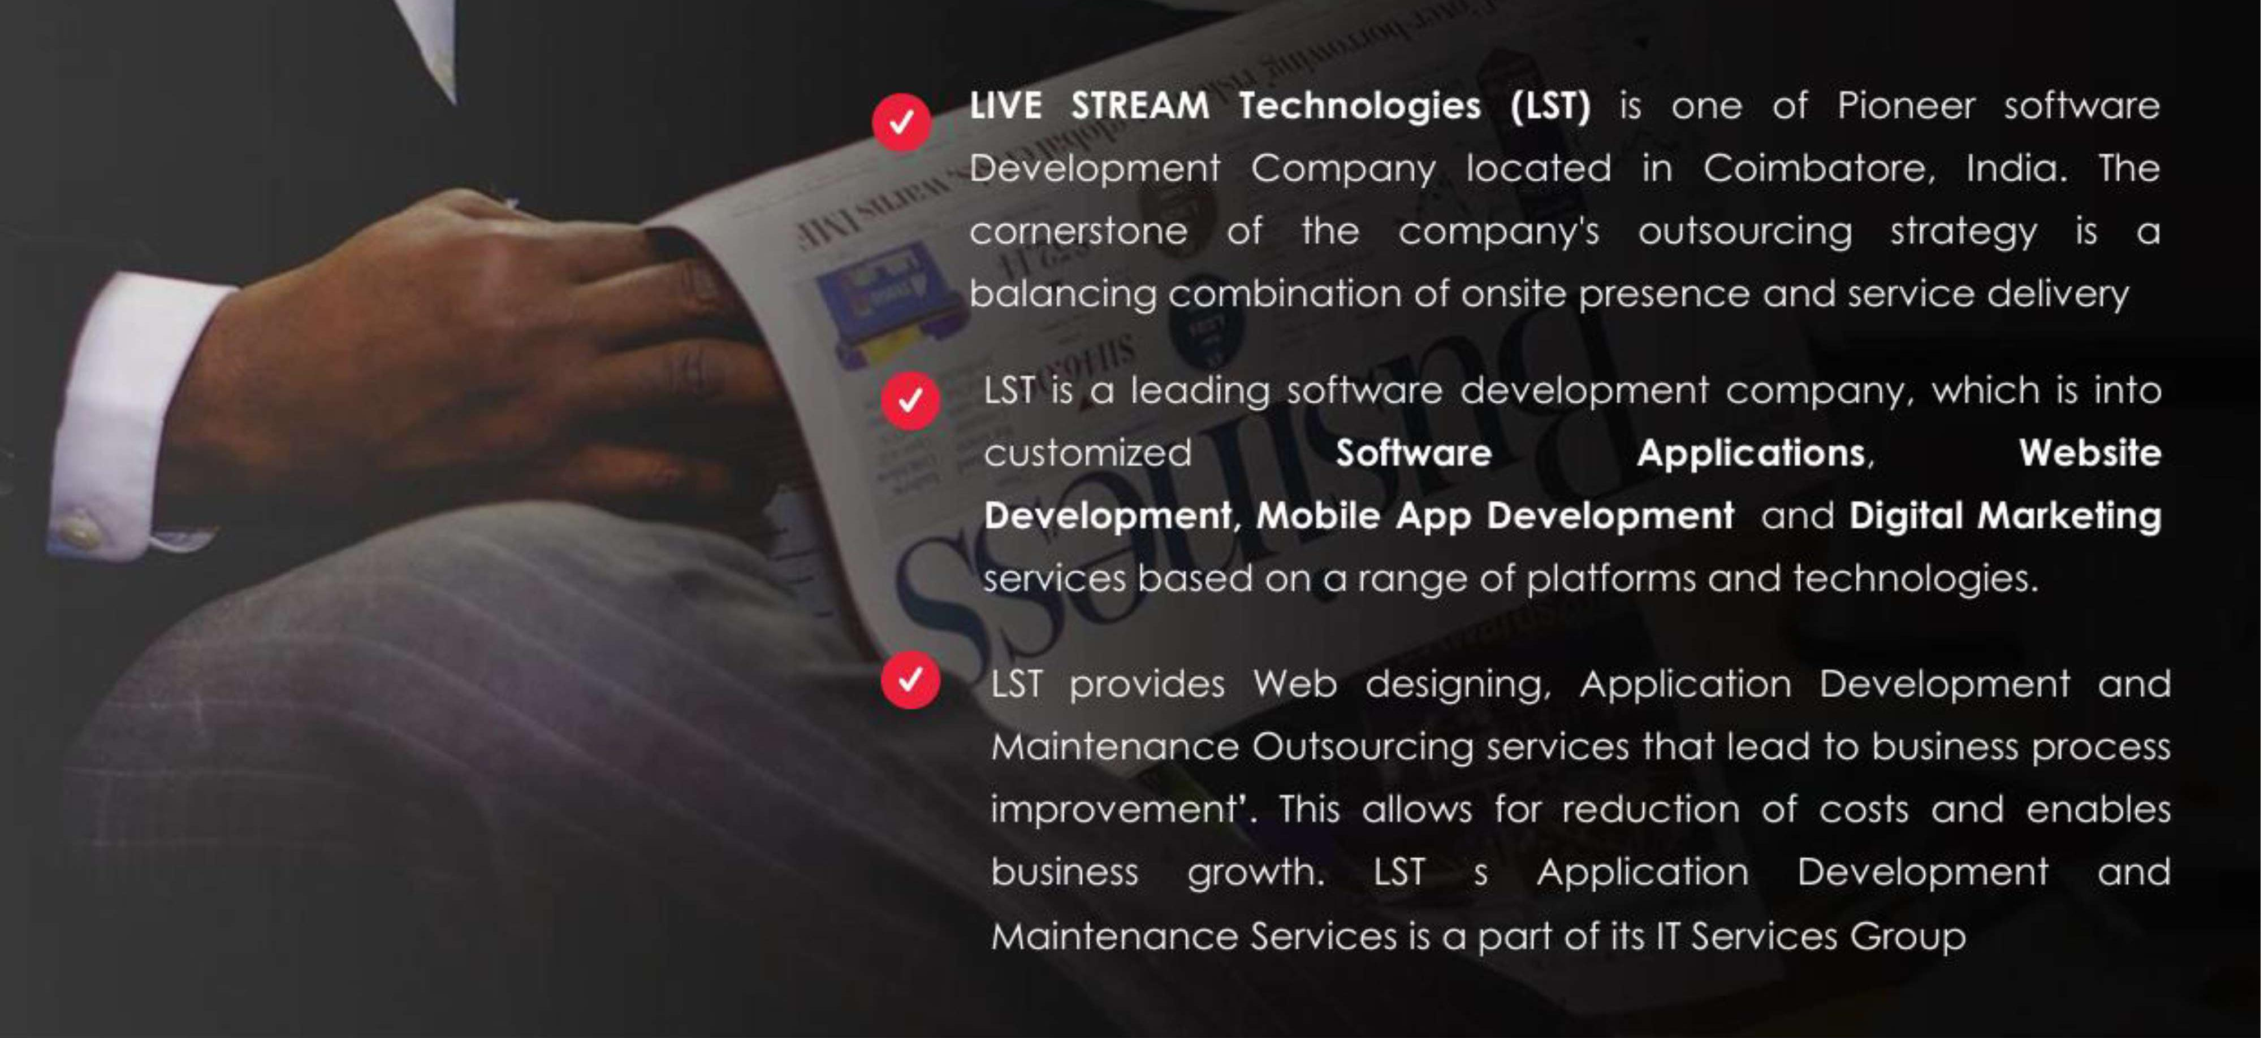
About The Company

Slide 4
Problem Definition
Grievance Management System(GMS) is a web-based application designed to provide an online way of solving the public and the organization’s problems. This application software is used to record, resolve & respond to the user’s grievance request and the grievance’s approval, and the user receives a response.
We aimed to develop this application software to make grievances easier to Coordinate, Monitor, Track, and Resolve in time. The objective was to provide the organization with an efficient tool to prioritize the target problem areas and improve them. Another reason for developing this application software is to replace the manual record work with an efficient and accurate online record system to enhance work-time constraints.
The GMS is developed to enhance the current (manual) grievance system by using the web application. Therefore, the GMS can provide several channels for filing the complaint, enabling the users to send the complaint easily and giving the channel for progress reporting by using the web application.
Moreover, the application can classify the complaint and directly send it to the responsible department; therefore, the system could reduce hiring the operation staff and time of the operation. Furthermore, the GMS allows the employees to manage the complaint through the web application instead of manually on the paper form.

Slide 5
Existing System
It’s a manual process for an earlier system.
It’s more time-consuming for all processes.
There is a chance to not resolve user problems.
Management is a chance to forget user complaints.

Slide 6
Proposed System
We want to replace existing manual GMS (Grievances Management System) to an application changing the way of maintaining the society complaints will also prove to be beneficial, improve efficiency and save us time.
By using this application people can register their complaints in easy and proper format .They will also well aware about their complaints progress. They can also provide feedback about their complaints progress weather they are satisfied or not.
Also the user can post their requirements through this system and they will receive needed items by admin within couple of hours ,its depending on the needed item and you can also look your status about your requirements. These user complaints, needs requirements maintain by admin. The User post feedback of these GMS system and admin can view this feedback.

Slide 7
SYSTEM CONFIGURATION
Hardware Configuration
Processor: Core i3
RAM: 2GB
Speed: 1.3GHz or above
Hard Disk: 250 GB
I/O Devices: Standard Keyboard & Logitech Mouse

Slide 8
SYSTEM CONFIGURATION
Software Configuration
Front-End: HTML
Client-Side: JAVASCRIPT
Server-Side: PYTHON
Back-End: MYSQL
Browser: IE 6.0 or Later, Firefox, Chrome

Slide 9
SYSTEM IMPLEMENTATION
Front-End Technologies:
HTML: For structuring the web pages.
CSS: For styling and making the web pages visually appealing.
JavaScript: For adding interactivity and enhancing user experience on the client side.
Back-End Technologies:
Python: The primary programming language used for server-side logic.
Framework (Django or Flask):
Django: Preferred for its robustness, built-in admin interface, and comprehensive features.
Flask: An alternative lightweight framework, suitable for simpler applications.
Database:
MySQL: A relational database used to store user data, complaints, statuses, and other necessary information.

Slide 10
DEVELOPMENT TOOLS
Integrated Development Environment (IDE):
Tools like PyCharm or Visual Studio Code to write and manage the code effectively.
Version Control System:
Git for tracking changes and collaborating with other developers.
Browser:
Latest versions of Chrome, Firefox, or Internet Explorer for testing the web application.

Slide 11
THANK
  YOU

